Slide 1

EEC 289A Final Project
Attempting to Solve Sokoban using DQN
Kolin Guo, Fengqiao Yang, Daniel Vallejo
University of California, Davis
Mar 20, 2020
Notes:
Presenter: Kolin Guo
Introduce team members

Slide 2
EEC 289A
Final Project
Presentation Sections
Introduction
Sokoban Game
OpenAI Gym (gym-sokoban)
Training with DQN
Evaluation Results
Additional Improvements
Attempting to Solve Sokoban
using DQN
Notes:
Presenter: Kolin Guo

Slide 3
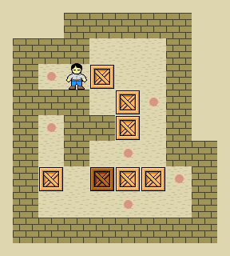
Sokoban
A puzzle video game
The player pushes boxes around in a warehouse, trying to get them to target locations.
The goal is to explore the optimal strategy for pushing all boxes into targets with fewest moves.
Notes:
Presenter: Fengqiao Yang

Slide 4
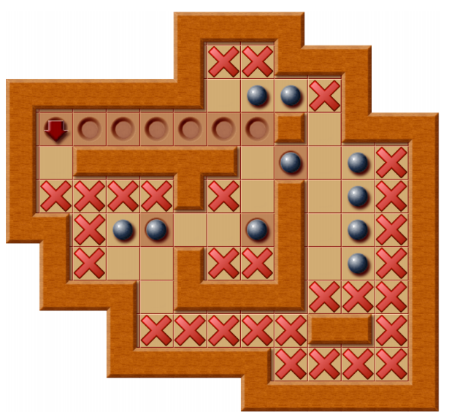
Sokoban
The possibility of making irreversible mistakes (deadlocks) makes Sokoban very challenging
Especially for Reinforcement Learning algorithms
PSPACE-complete
Hardest problem that can be solved by a Turing machine using a polynomial amount of space
In a 20x20 Sokoban, average branching factor is 12
On average, a player has 12 legal moves at each game state.
Chess is 35, Go is 250.
Notes:
Presenter: Fengqiao Yang
First bullet point: An example of deadlock is shown in the right figure: locations with red crosses are dead locations. If a box is pushed into these locations, it can never be pushed into a target location afterwards.
Conclusion: These show that the Sokoban game is difficult to solve and requires understanding of multiple sequential actions.

Slide 5
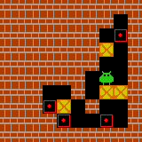
Gym-Sokoban
Build on OpenAI Gym Environment
observation, reward, terminal, info = env.step(action)
Uses DeepMind pregenerated Sokoban puzzles
Train / Validation / Test: 900k / 100k / 1k puzzles
10 x 10 grid size, 4 boxes
8 x 8 non-deterministic grid space
7 rendering textures: wall, floor, target, boxes * 2, players * 2
Upper-bound state space: 7^{8*8} = 7⁶⁴ ≈ 10⁵⁴
4 actions
Push up, down, left, and right
Notes:
Presenter: Kolin Guo

Slide 6
EEC 289A
Final Project
Presentation Sections
Introduction
Sokoban Game
OpenAI Gym (gym-sokoban)
Training with DQN
Evaluation Results
Additional Improvements
Attempting to Solve Sokoban
using DQN
Notes:
Presenter: Kolin Guo

Slide 7
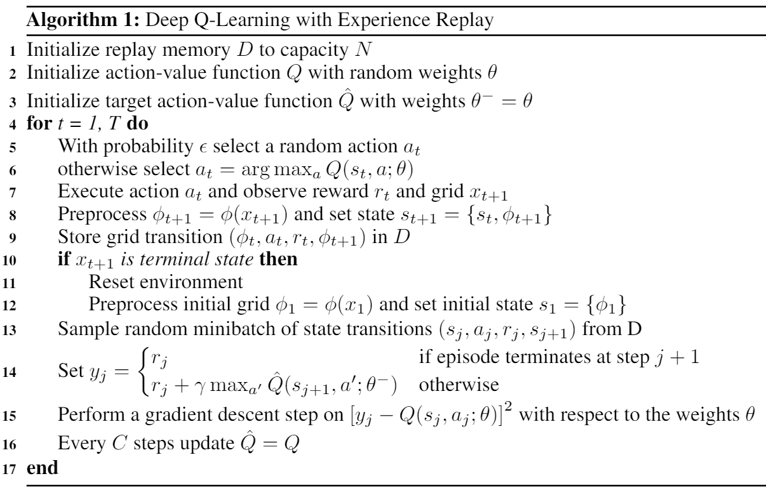
Deep Q-Learning with Experience Replay
Notes:
Presenter: Kolin Guo

Slide 8
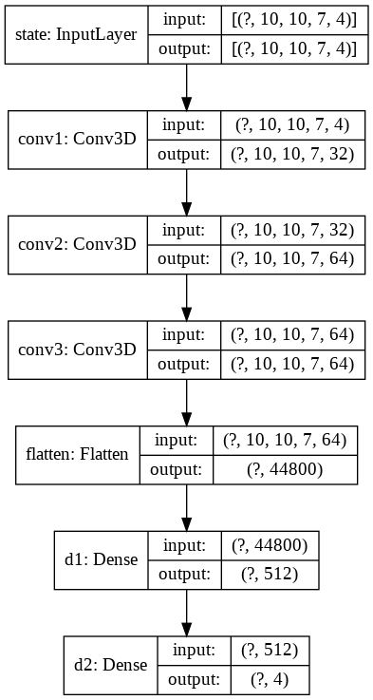
Deep Q-Network (DQN)
Observation from gym-sokoban
10 x 10 x 3 RGB pixelated grid
Preprocessing into 10 x 10 x 7 binary feature planes (7 rendering textures)
Accumulate 4 consecutive grids as a state (sequential understanding)
Store (10 x 10 x 7 x 4) dimensional state into replay memory
DQN architecture
Tensorflow 2.1.0 (tf.keras)
Three 3D convolution layers + Two fully-connected layers
Huber loss (partially linearized squared-error loss to reduce variance)
RMSprop optimizer
Trained with one Nvidia Titan Xp GPU
Evaluated with Googla Colab
Notes:
Presenter: Kolin Guo

Slide 9
EEC 289A
Final Project
Presentation Sections
Introduction
Sokoban Game
OpenAI Gym (gym-sokoban)
Training with DQN
Evaluation Results
Additional Improvements
Attempting to Solve Sokoban
using DQN
Notes:
Presenter: Kolin Guo

Slide 10
Rewards
Action | 1x Reward | 10x Reward
Perform a Step | -0.1 | -0.1
Push Box on Target | 1.0 | 10.0
Push Box off Target | -1.0 | -10.0
Push All Boxes on Targets | 10.0 | 100.0
Notes:
Presenter: Fengqiao Yang

Slide 11
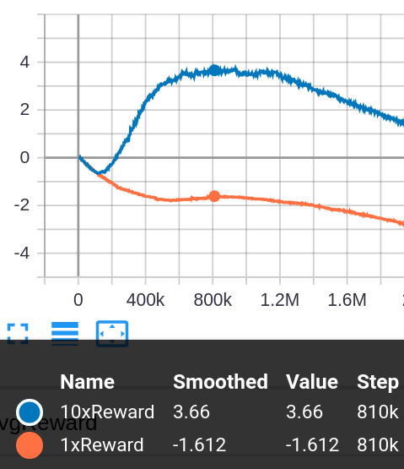
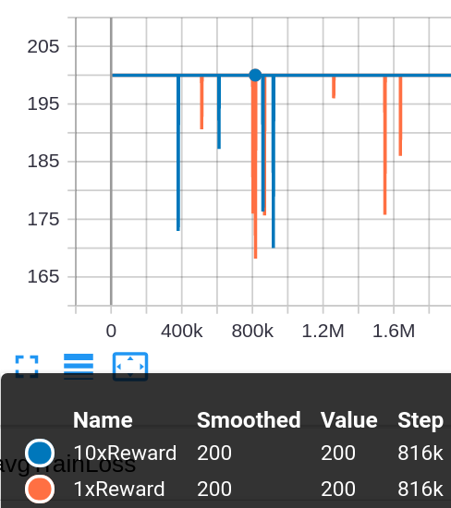
Training Results
Average Q Value
Average Steps per Episode
Notes:
Presenter: Kolin Guo

Slide 12
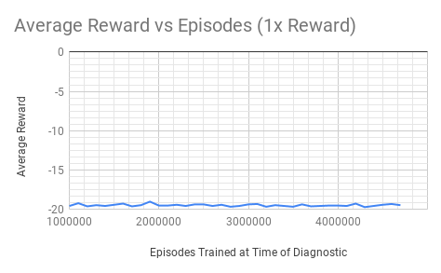
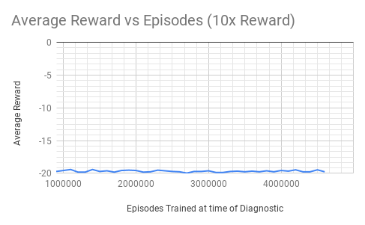
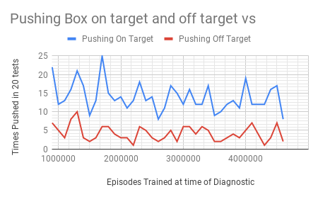
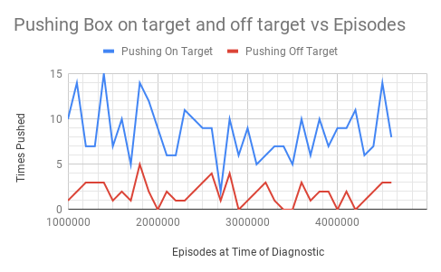
Testing Results
Notes:
Presenter: Daniel Vallejo

Slide 13
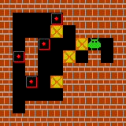
Gameplay Demo
Network trained for 800k steps with 10x rewards
Success in initial pushes
Pushed two boxes on targets
Fail in future actions
Stuck at the top-right corner afterwards
Possible causes
Only sees previous 4 actions
Reward setup & values
Action types
Notes:
Presenter: Fengqiao Yang

Slide 14
EEC 289A
Final Project
Presentation Sections
Introduction
Sokoban Game
OpenAI Gym (gym-sokoban)
Training with DQN
Evaluation Results
Additional Improvements
Attempting to Solve Sokoban
using DQN
Notes:
Presenter: Fengqiao Yang

Slide 15
Additional Improvements
Switch from purely CNN model to CNN+LSTM model for better sequential understanding
Instead of fixing 4 consecutive grids (only 4 sequential moves are seen by the network)
Use deadlock detection algorithm to generate another feature plane of next-step deadlock locations
Include this extra feature plane for training
Similar to AlphaGo (number of liberties after this move is played)
Employ Asynchronous Advantage Actor-Critic (A3C) algorithm instead of Q-learning as our RL algorithm
Enables multiple agents playing at the same time and asynchronously update the network
Significantly better training efficiency compared to DQN on Atari games
Notes:
Presenter: Kolin Guo

Slide 16
References
M.-P. B. Schrader, “gym-sokoban,” https://github.com/mpSchrader/gym-sokoban, 2018.
Mark Sinton, “DQN_Atari,” https://github.com/msinto93/DQN_Atari, 2018.
Culberson, Joseph C.. “Sokoban is PSPACE-complete.” (1997).
Nils Froleyks. “Using an Algorithm Portfolio to Solve Sokoban.” (2016).
A. Junghanns and J. Schaeffer. “Sokoban: Enhancing general single-agent search methods using domain knowledge,”Artificial Intelligence, vol. 129, no. 1-2, p. 219–251, 2001.
V. Mnih, K. Kavukcuoglu, D. Silver, A. Graves, I. Antonoglou, D. Wierstra, and M. A.Riedmiller, “Playing atari with deep reinforcement learning,” CoRR, vol. abs/1312.5602, 2013.[Online]. Available: http://arxiv.org/abs/1312.5602
V. Mnih, K. Kavukcuoglu, D. Silver, et al. “Human-level control through deep reinforcement learning,” Nature, vol. 518, pp. 529–33, 02 2015
D. Silver, A. Huang, C. J. Maddison, et al. “Mastering the game of go with deep neural networks and tree search,” Nature, vol. 529, pp.484–489, 2016.
V. Mnih, A. P. Badia, M. Mirza, A. Graves, T. P. Lillicrap, T. Harley, D. Silver, andK. Kavukcuoglu, “Asynchronous methods for deep reinforcement learning,” CoRR, vol.abs/1602.01783, 2016. [Online]. Available: http://arxiv.org/abs/1602.01783
L. Orseau, L. H. S. Lelis, T.Lattimore, and T. Weber, “Single-agent policy tree search with guarantees,” CoRR, vol. abs/1811.10928, 2018. [Online]. Available: http://arxiv.org/abs/1811.109282
Notes:
Presenter:

